Slide 1
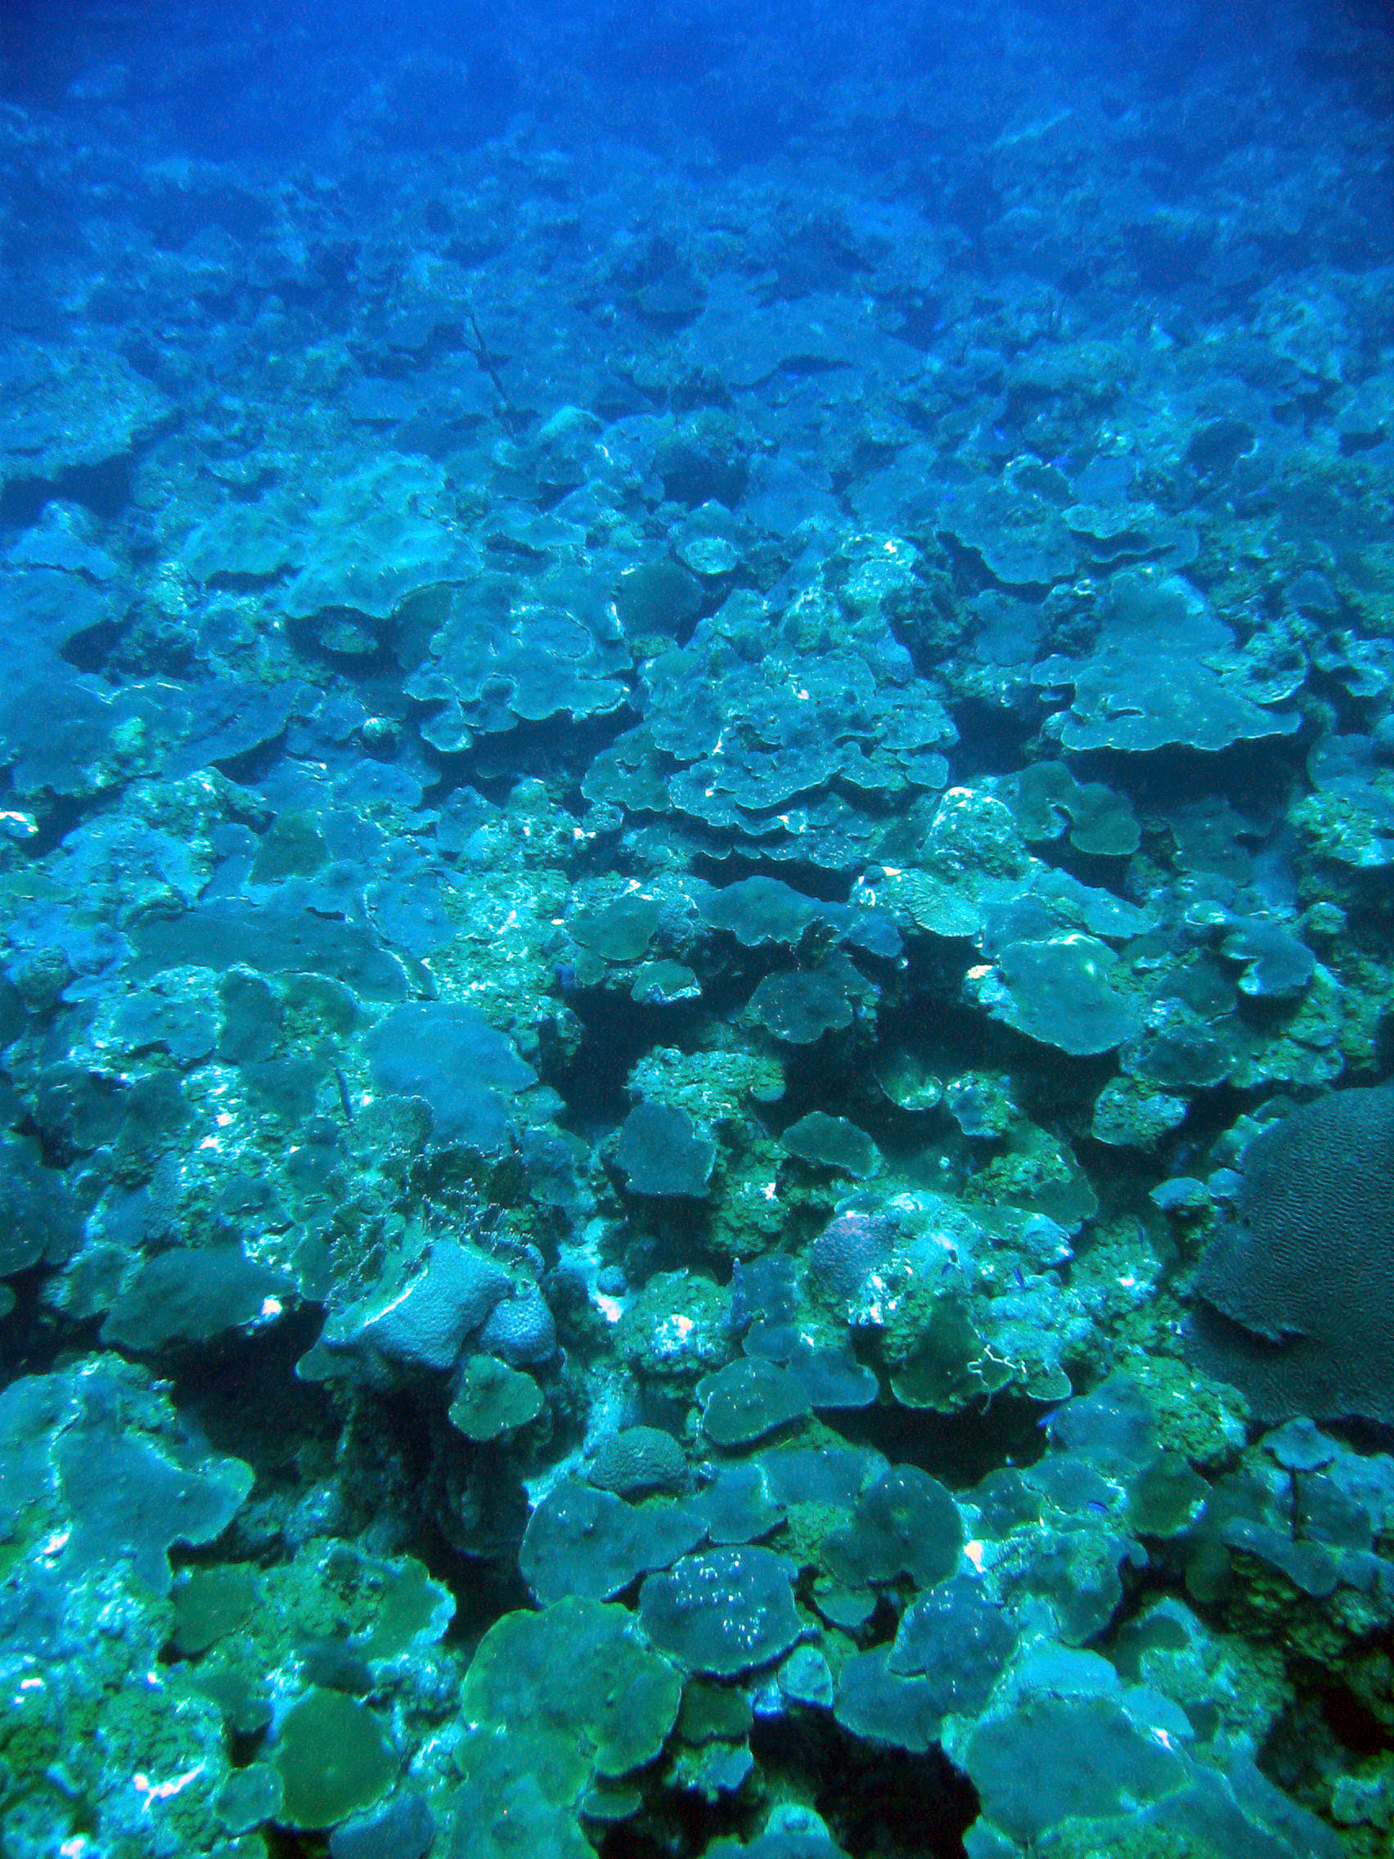






The Relevance of Refugia for Corals and Coral Reefs of the Future
Tyler B. Smith
University of the Virgin Islands

Slide 2
Refuge(s) vs. Refugium(ia)
Definitions after Keppel et al. 2012:
Refuges are “microhabitats providing spatial and/or temporal protection from disturbances or advantages in biotic interactions.”
  e.g., refuges from predation, competition, stress
Refugia are “habitats that components of biodiversity retreat to, persist in and can potentially expand from under changing environmental conditions.”
  e.g., Quaternary refugia of temperate European trees from glaciation (Tzedakis et al. 2002)

Slide 3
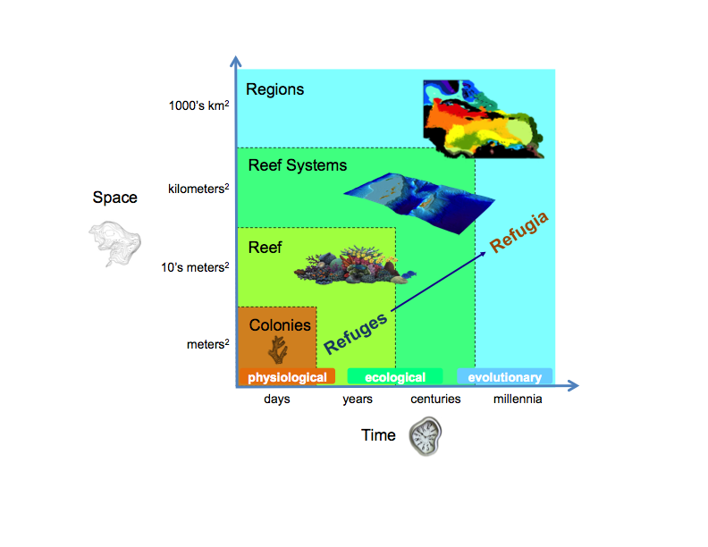
Image credits: NOAA, Iliana Chollett
Notes:
A refuge is a prerequisite feature of a refugium, yet not every refuge will result in a refugium. If they are to scale-up to the level or refugia, refuges must be persistent over multiple disturbances, and often over multiple types of disturbances and stressors. For example, the negative effects of ocean acidification on long-term coral growth and survival may compromise a deep refuge from thermal stress and preclude the realization of a deep refugium from modern global anthropogenic stressors. Thus, refuges are interesting ecological phenomena, as they suggest mechanisms that can positively affect the demographics of organisms in the face of short and long-term stressors. However, to maintain biodiversity over global change scales refuges must be robust at increasing spatio-temporal scales.

Slide 4
Conditions for a Refugium
Refuge = necessary, but insufficient condition for a refugium
Refuges suggest mechanisms that can positively affect the demographics of organisms in the face of short and long-term stressors
To scale to refugia…refuges must be persistent over multiple disturbances/multiple types of disturbances and stressors
  e.g., , the negative effects of ocean acidification on long-term coral growth and survival may compromise a deep refuge from thermal stress and preclude the realization of a deep refugium from modern global anthropogenic stressors.

Slide 5
Factors for Thermal Refuges
Lowered Temperature Glynn 1996, Riegl and Pillar 2003
Historical High Temperature D’Croz et al. 2001, Brown et al. 2002
Heterotrophic Subsidy Grotolli et. al 2006, Anthony et al. 2007
High Water Flow Nakamura and Van Woesik 2001
Reduced Light Mumby el al. 2002
Low Co-occurring Stressors? Paine 1998, Nyström et al. 2000, Knowlton 2001, or Anthony et al. 2007

Slide 6

A. Colonies as a refuge from thermal stress
Many coral morphologies are highly heterogeneous, leading to microhabitats
Some microhabitats are buffered from stress
  Shaded colony portions
  Deep tissue reservoirs (e.g., perforate colonies)
Heterogeneity may favor partial mortality in response to bleaching and other disturbance (Done 1985, Glynn and Fong 2005)

Slide 7
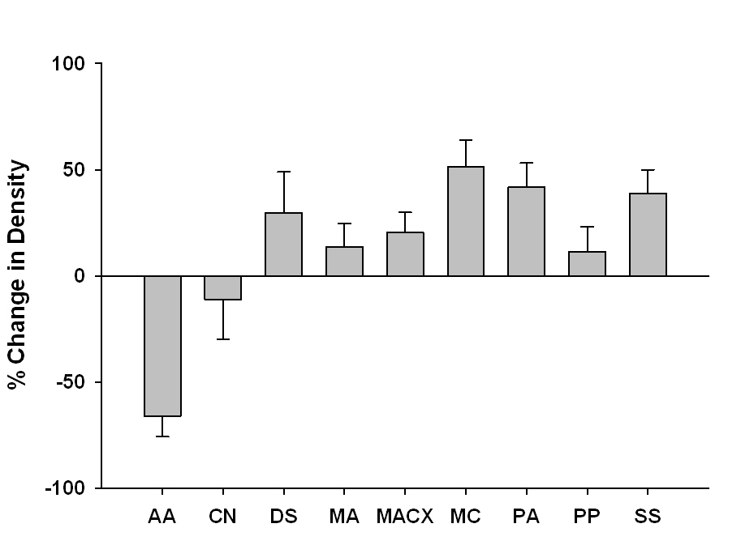
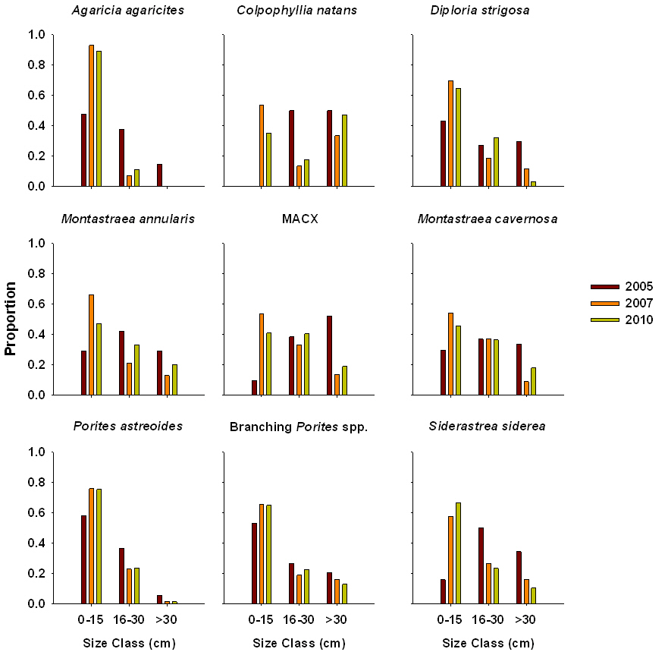
A. Colonies as a refuge from thermal stress
Density
Size
Montastraea annularis
spp. complex
A. agaricites
M. Annularis spp.
Branching
Porites
P. astreoides
Response of 9 focal species to the 2005 Caribbean Bleaching Event
Majority of species had no density change in colonies but underwent fission and transitions to smaller size classes
Data Source: USVI Territorial Coral Reef Monitoring Program
N = 18 sites, w/ 6 permanent transects, < 25 m depth

Slide 8
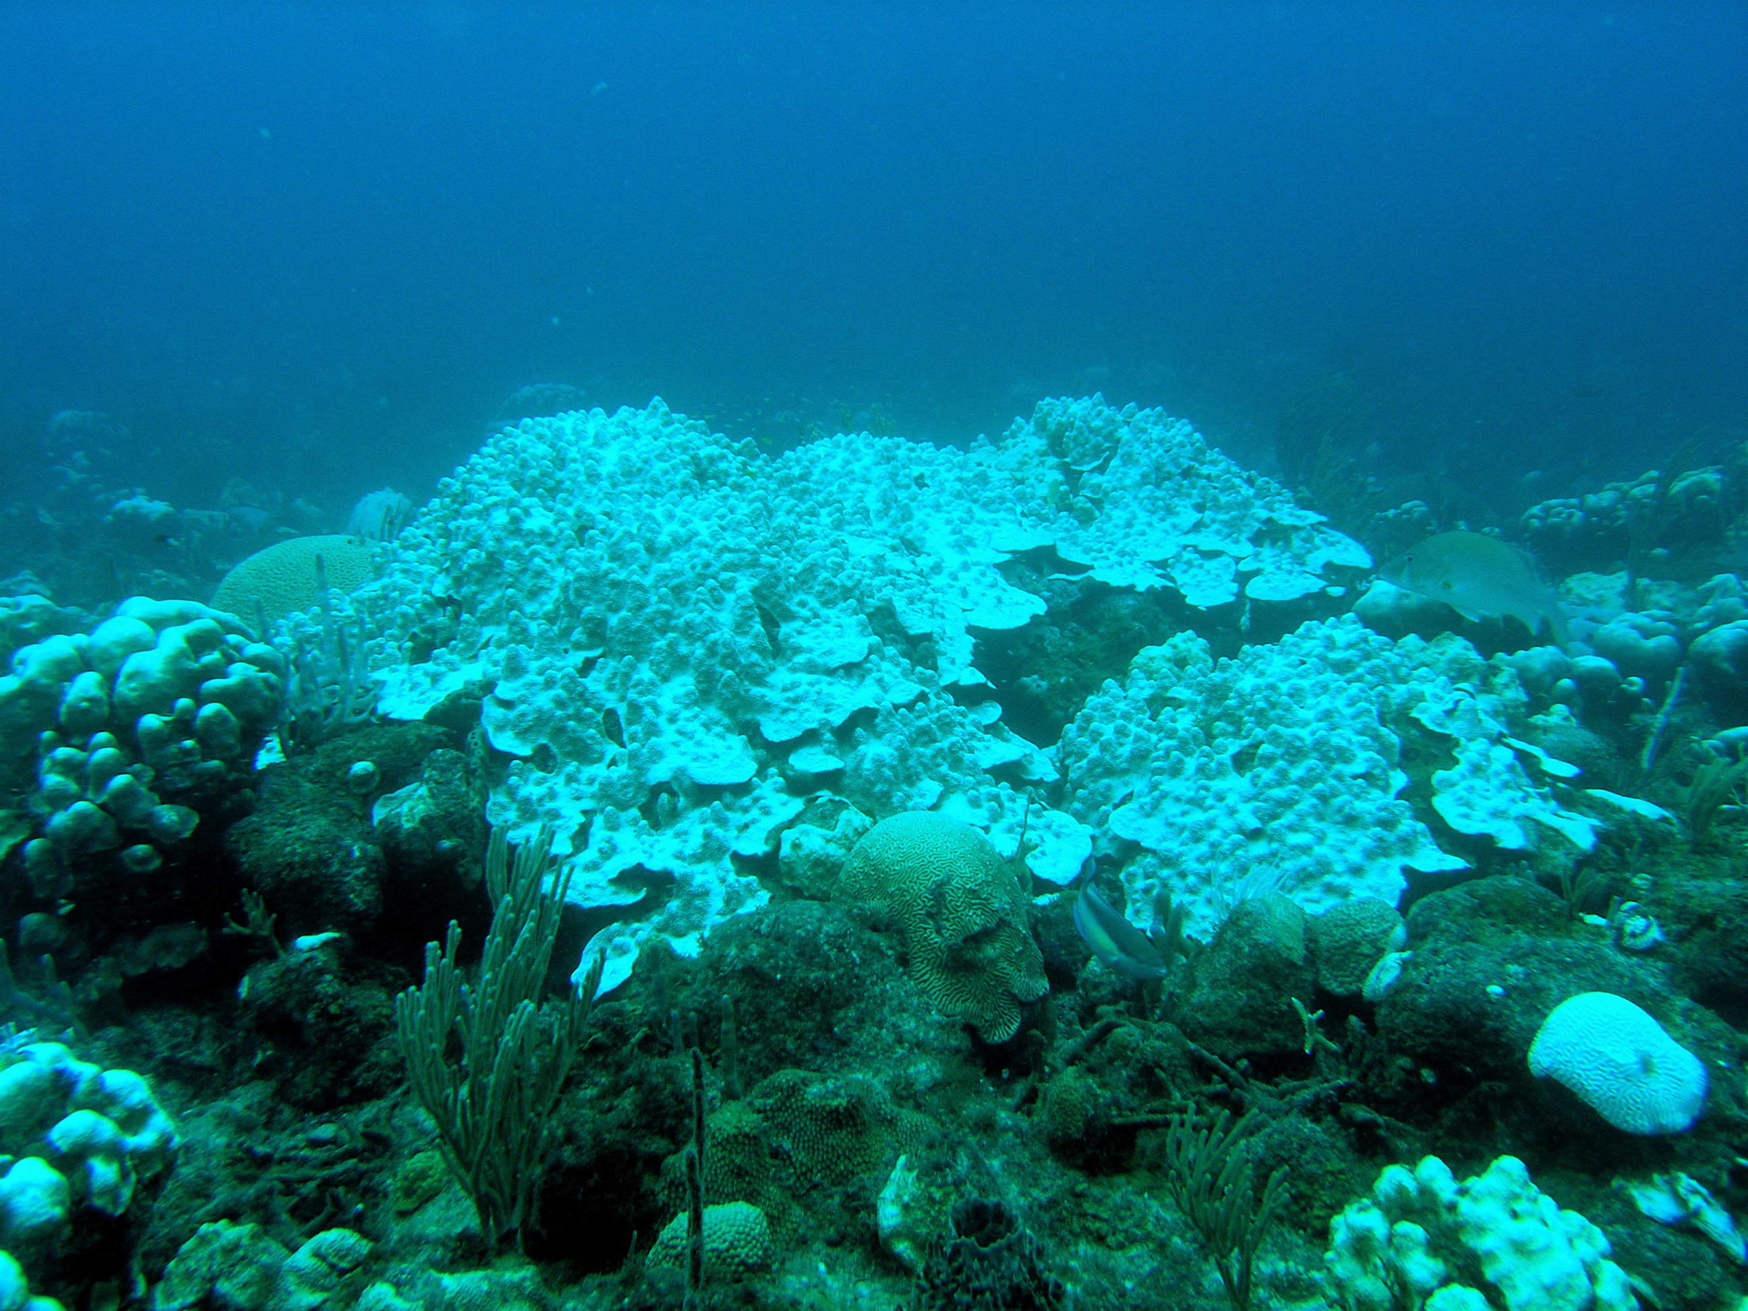
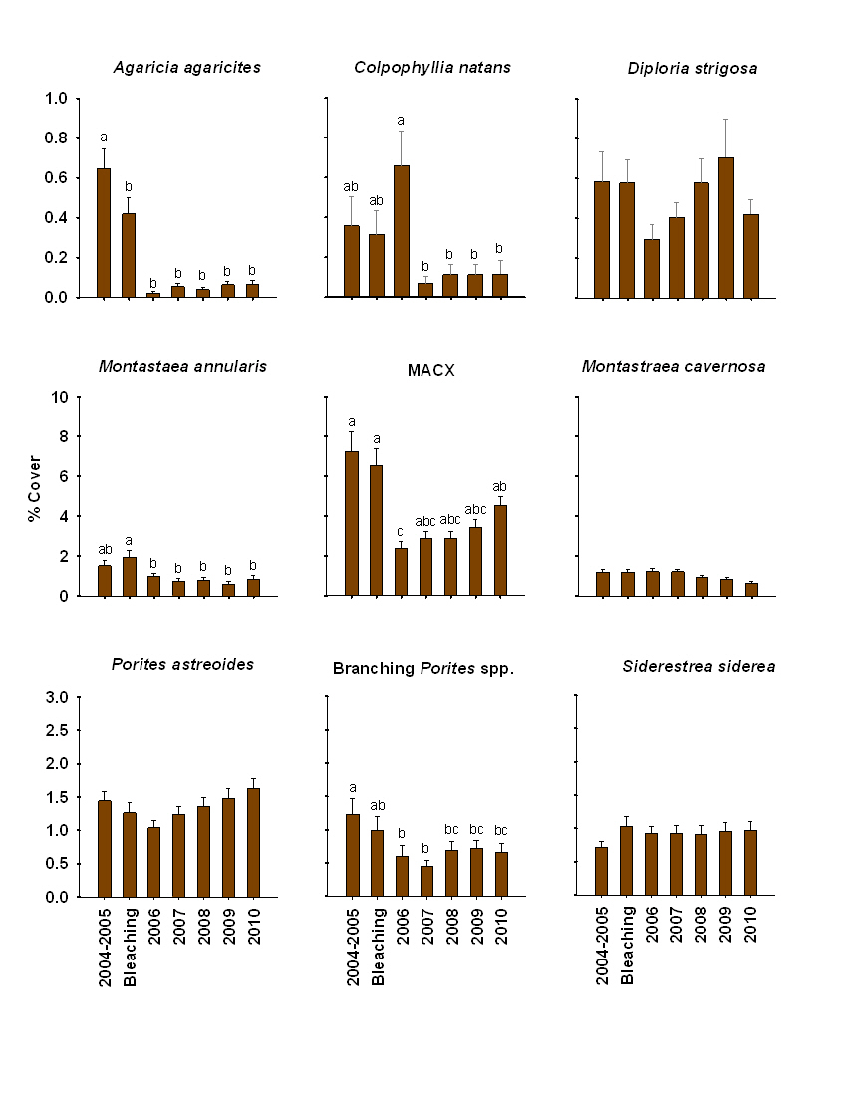
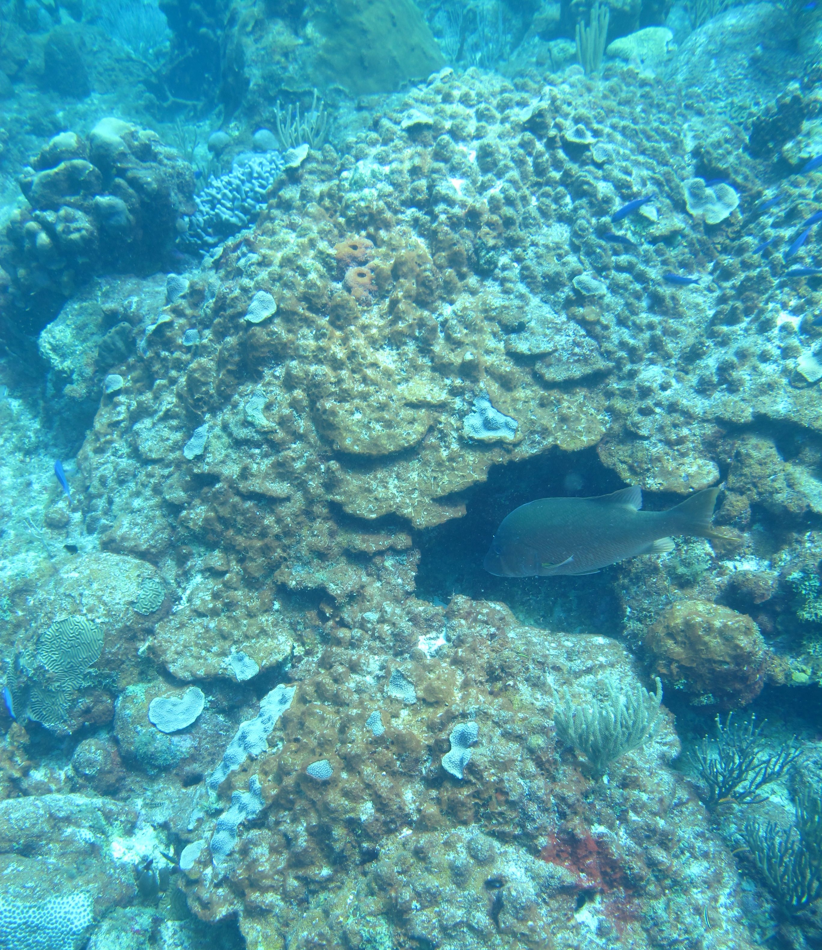
2005
Montastraea annularis
spp. complex
p = 0.0009
p = 0.0001
% Cover
2011
p = 0.104
p = 0.017
Time Period
Data Source: USVI Territorial Coral Reef Monitoring Program
N = 18 sites, w/ 6 permanent transects, < 25 m depth
Notes:
Add in the reduced file size MACX Savana. Present first. Maybe enhance color on the 2010 Agaricia/br. Porites.

Slide 9
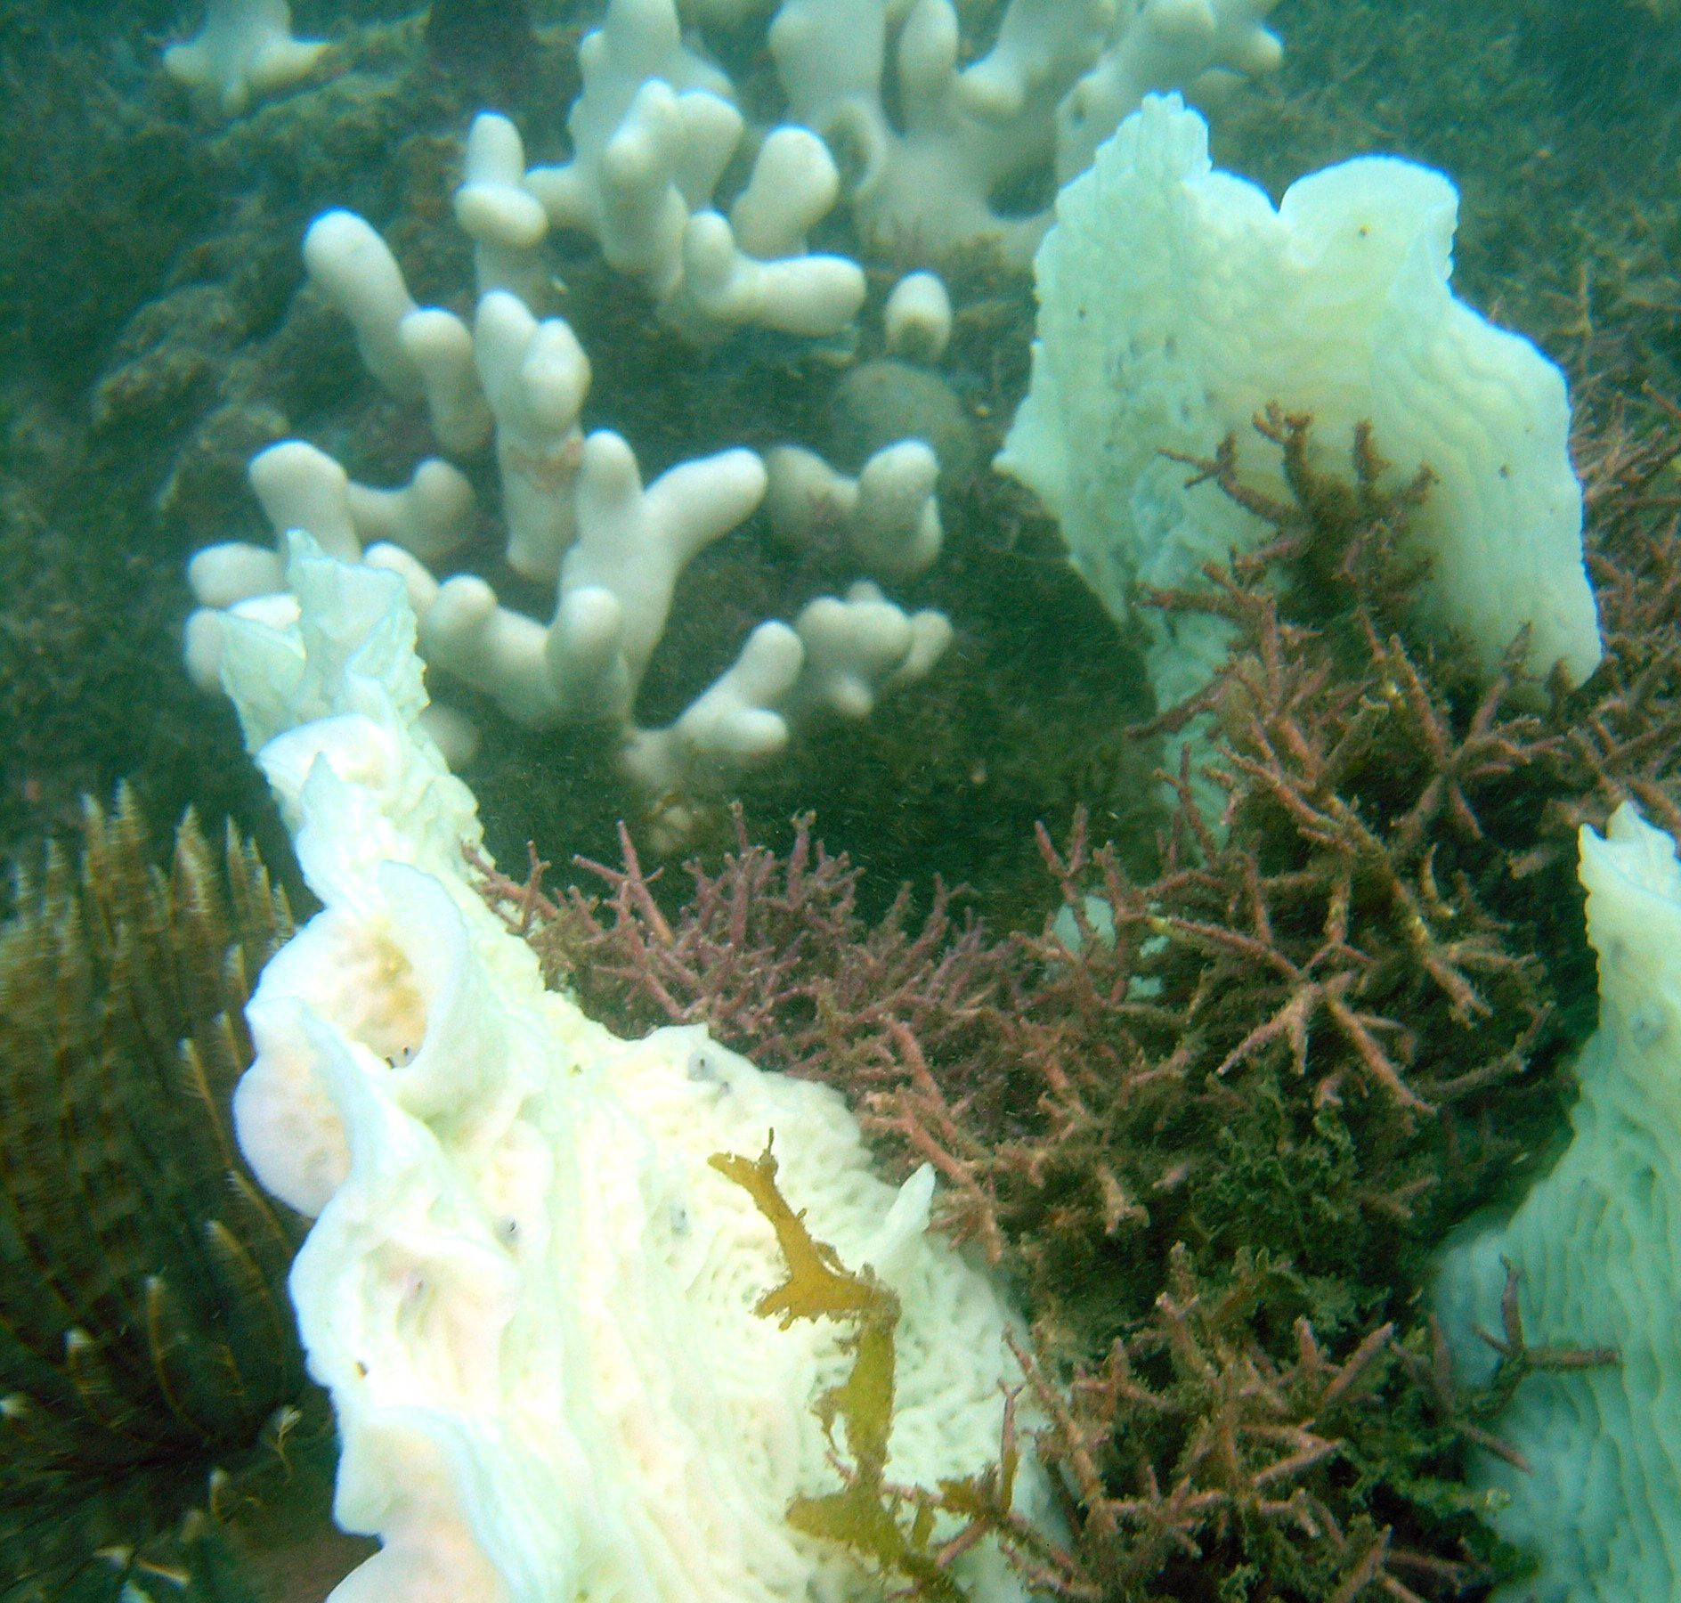
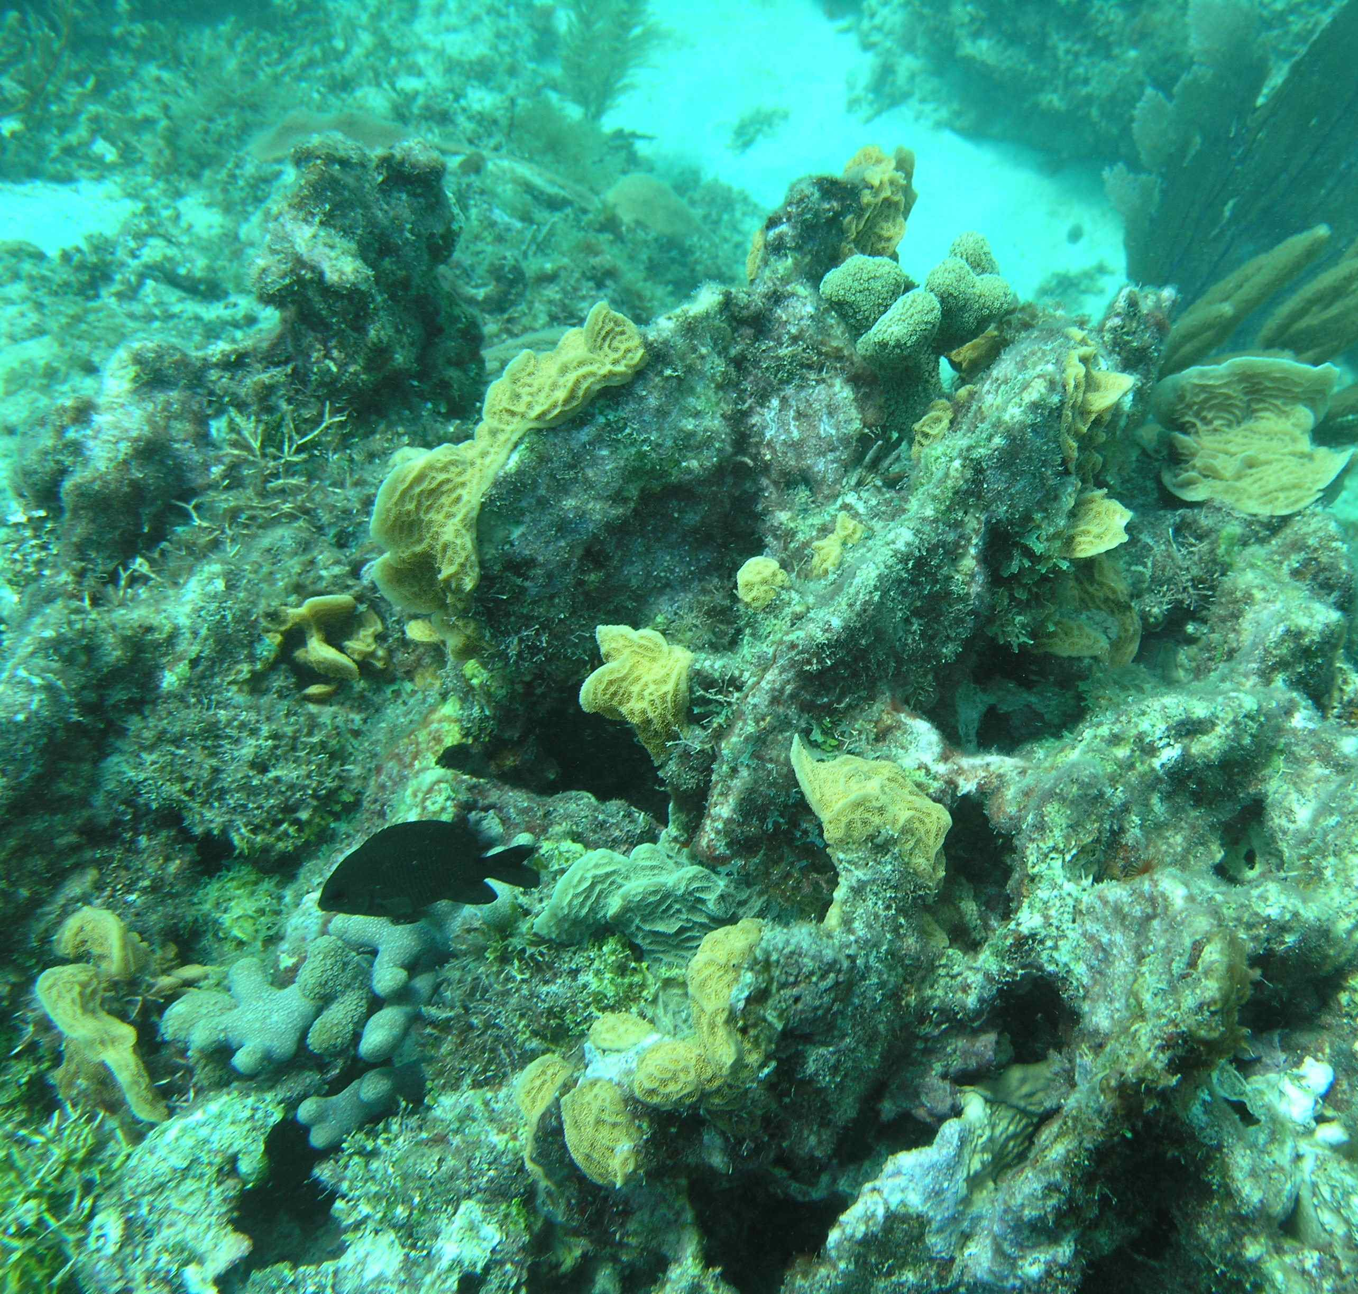
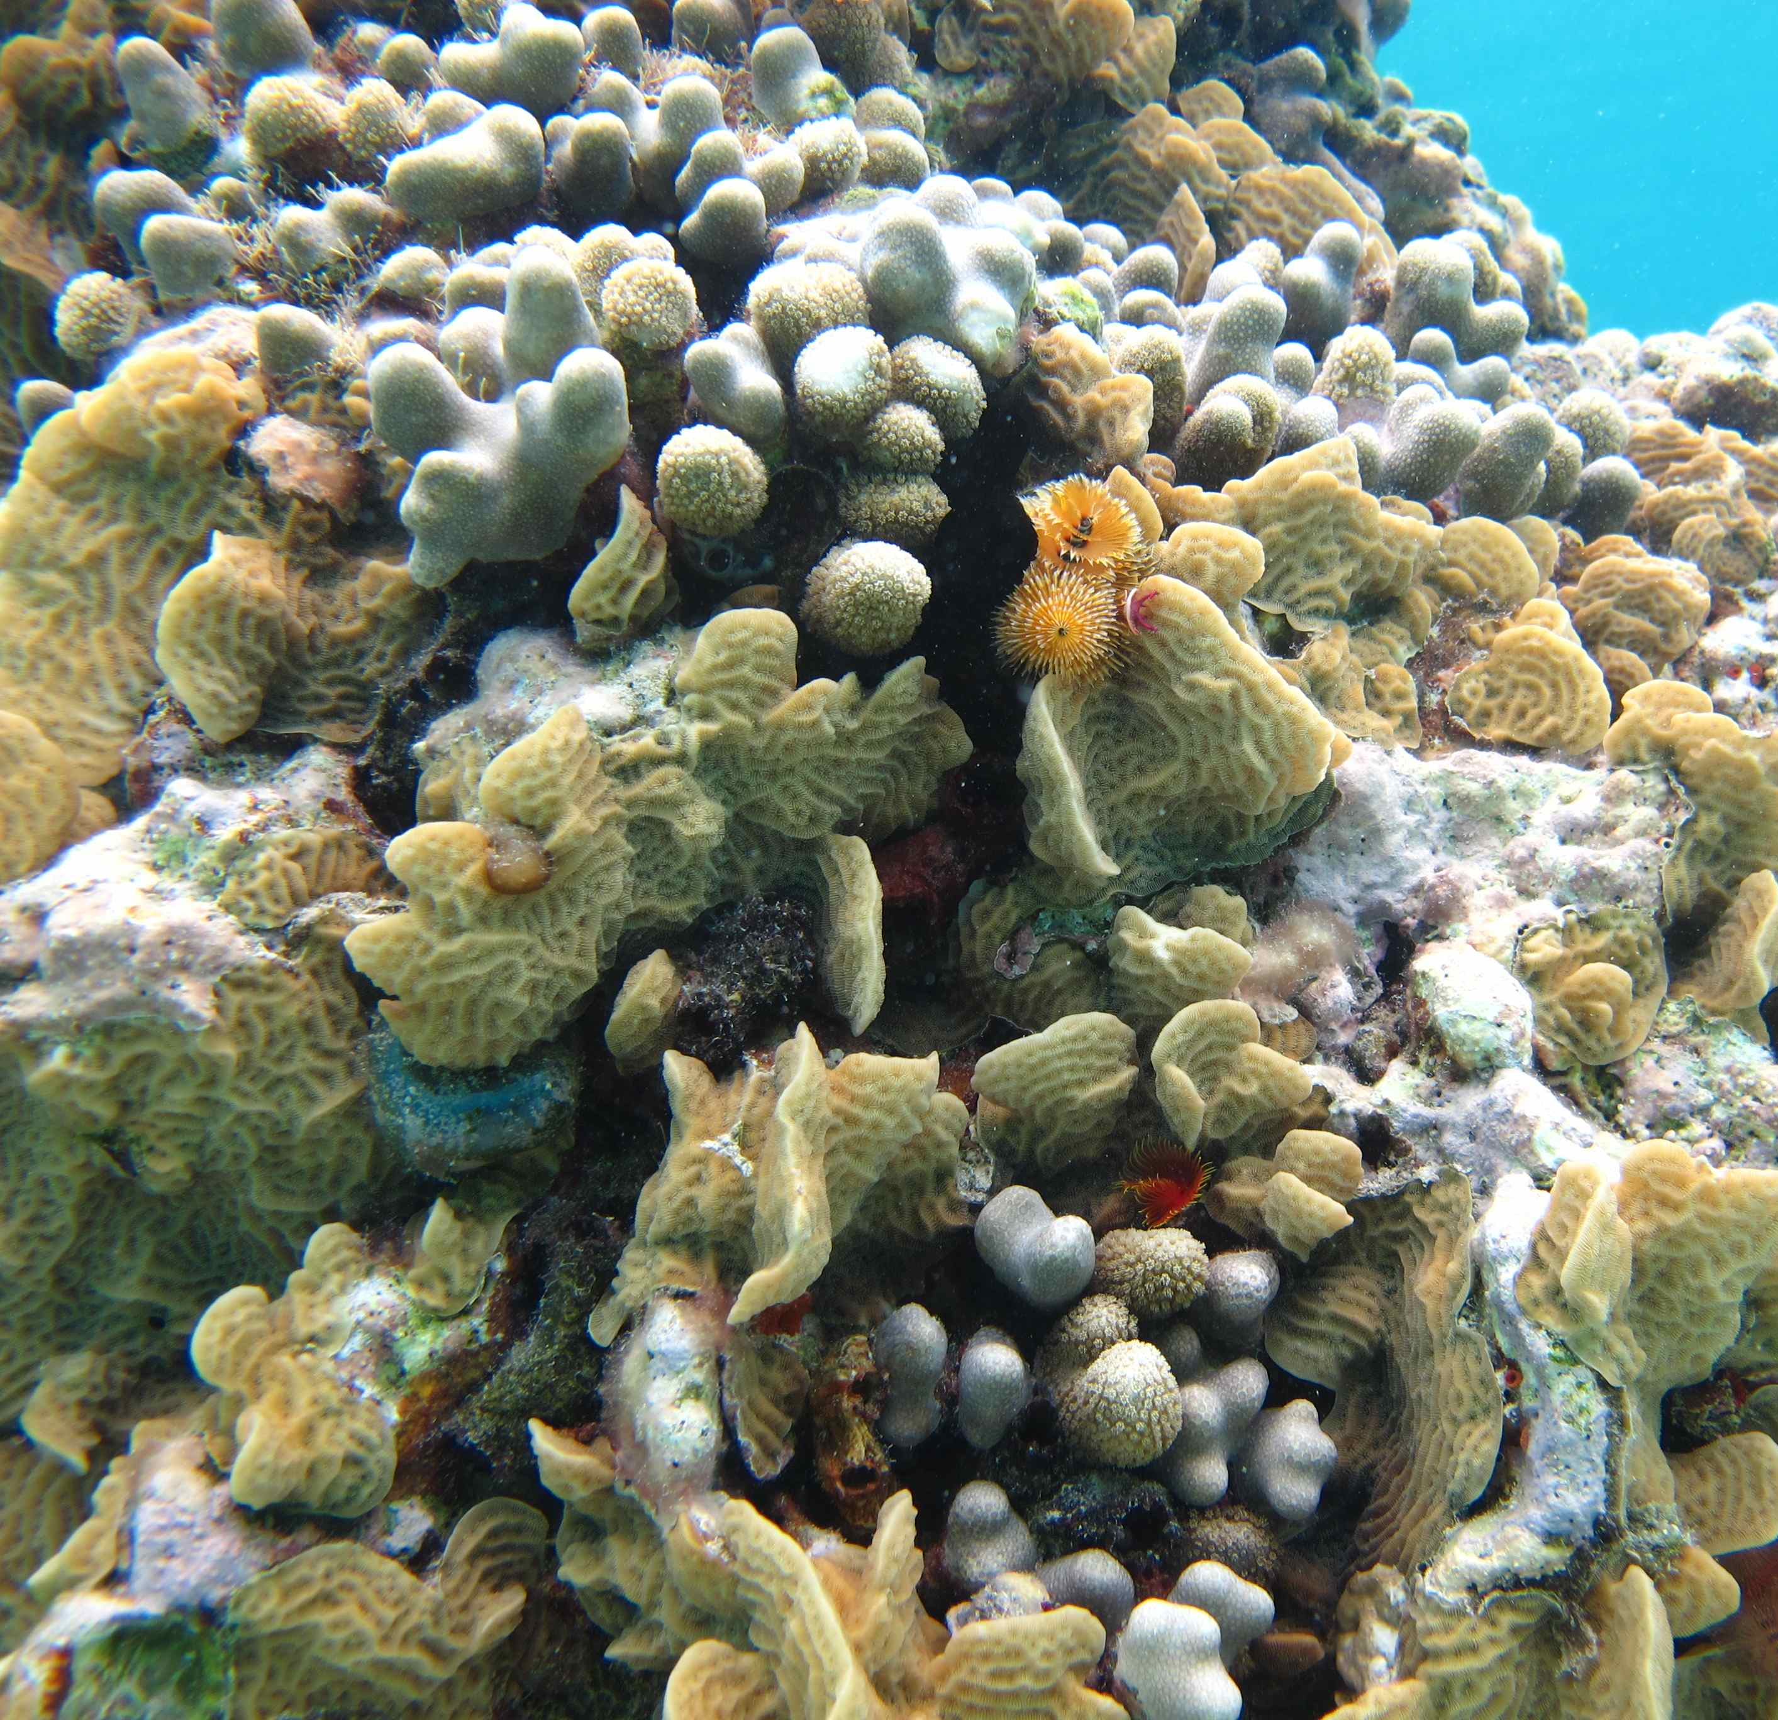
2005
Montastraea annularis
spp. complex
p = 0.0009
p = 0.0001
2010
% Cover
p = 0.104
p = 0.017
2012
Time Period
Data Source: USVI Territorial Coral Reef Monitoring Program
N = 18 sites, w/ 6 permanent transects, < 25 m depth
Notes:
Add in the reduced file size MACX Savana. Present first. Maybe enhance color on the 2010 Agaricia/br. Porites.

Slide 10
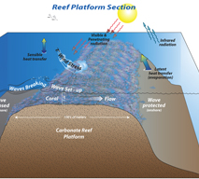
B. Reef habitat refuges from thermal stress
Bio-physical conditions also vary across coral reefs
Examples of heterogeneity
  Thermal (Gorospe and Karl 2011, Davis et al. 2011)
  Light
  Water motion
  Heterotrophic supply (Hamner et al. 2007)
Thermal patterns, intra-reef variation in bleaching
  e.g., Temperature VAR negatively correlated with bleaching. High VAR sites may represent a reef (and regional) refugium (McClanahan et al. 2005 & 2007)
Credit: K. Davis

Slide 11
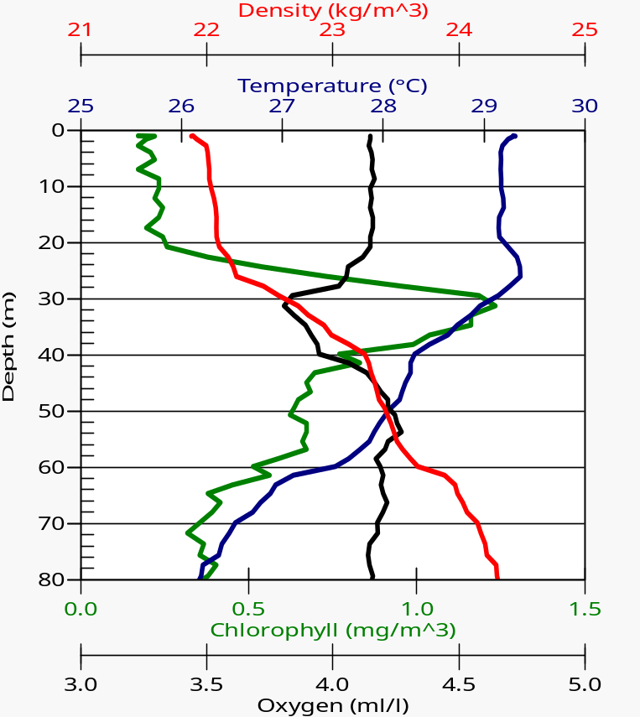
C. Reef Systems/Habitats as refuges
Bio-physical conditions vary across reef systems/habitats
Reefs are heterogeneous on vertical and horizontal axes
  Shelf position
  Depth - reduces light and temperature, potentially increases food supply (Glynn 1996, Riegl and Pillar 2003, Bongaerts et al. 2010)
Warm season CTD cast
St. Thomas, Caribbean
Oct. 9, 2007
7 m
30 m
Shelf Edge Midshelf Nearshore

Slide 12
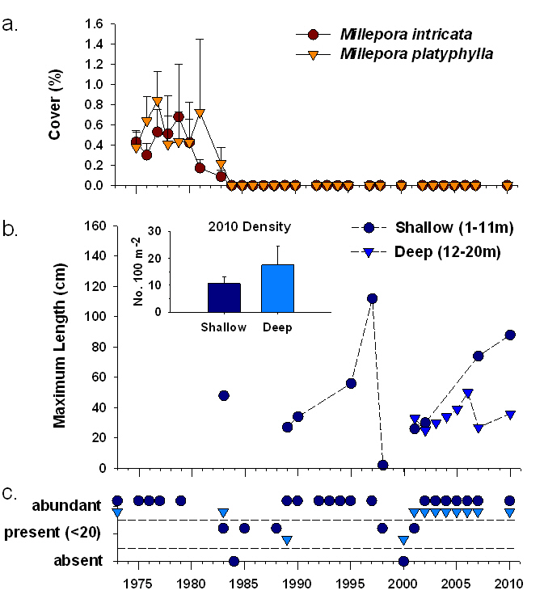
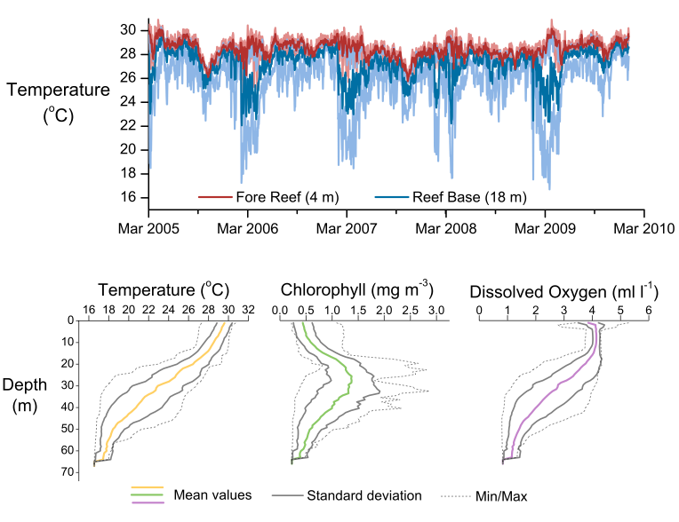
Depth Refuge and Millepora intricata
CTD Compilation Data
(March 2010)
Credit: J. Gyory
Data from the Gulf of Chiriquí, Panamanian Pacific; Smith, Glynn, Maté, Gyory (submitted)

Slide 13
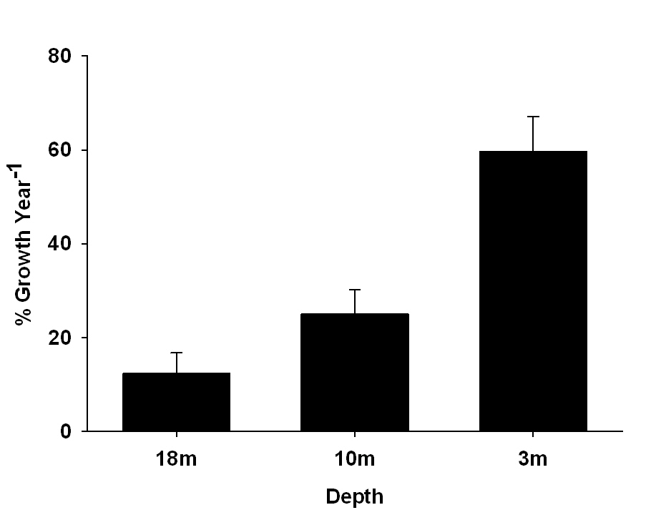
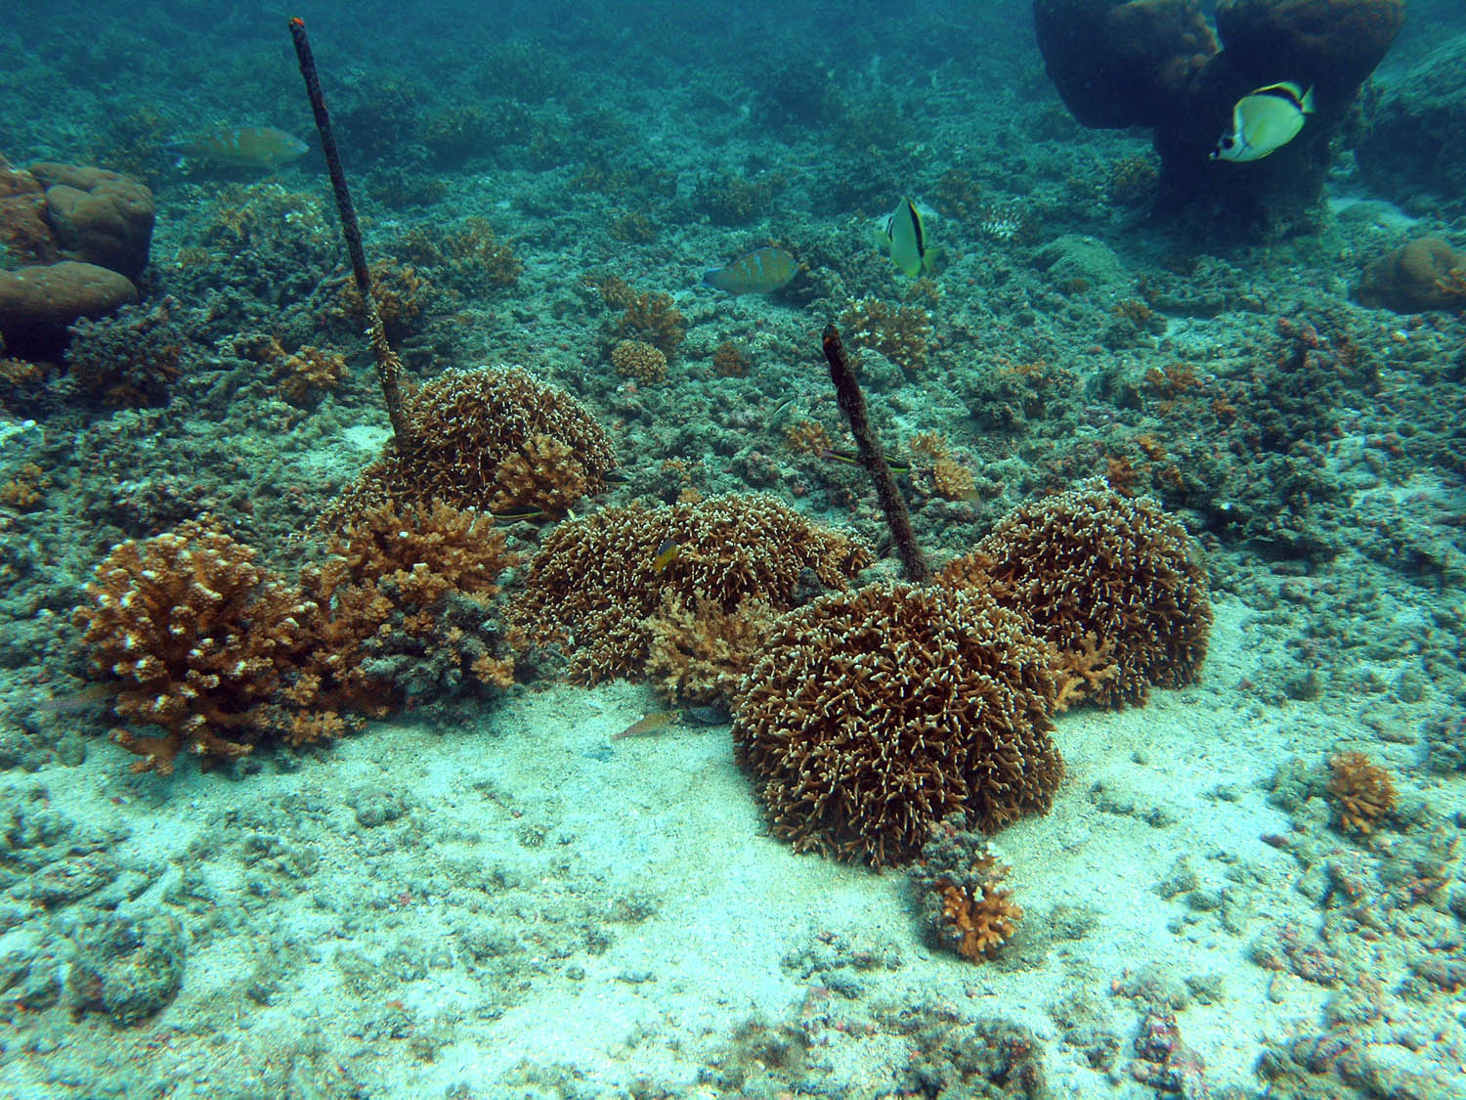
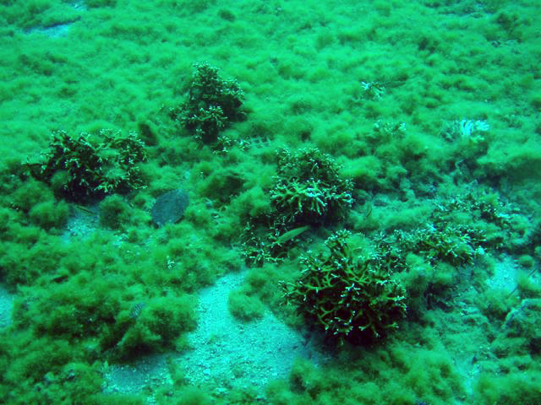
Deep Refuge and Millepora intricata
3m
1-way ANOVA
P = 0.0001
N = 39
a
b
18m
b
Data from the Gulf of Chiriquí, Panamanian Pacific; Smith, Glynn, Maté, Gyory (submitted)

Slide 14
  D. Intra-Regional Refuges
  Bio-physical conditions also vary across regions
Example of heterogeneity:
  Upwelling (Glynn 1996)
    Chollett et al. (2010) - In four upwelling regions studied, Oman and Venezuelan Caribbean had consistent stress reduction = upwelling refugia; Panamanian Pacific and N. Madagascar where inconsistent = upwelling refuges, but no upwelling refugia
    Karnauskas and Cohen (2012) - Equatorial upwelling, intensified by EUC, will mitigate some projected heating

Slide 15
Refuge/Refugium Strength
+
Moderately Strong
Very Strong
Refuge for
Biodiversity
E.g., Regional Upwelling
Refuge for
Biodiversity
E.g., ?
Moderately Strong
Moderately Strong
Diversity
within refuge
Refuge for some Biodiversity
E.g., Intra-reef thermal VAR
Refuge for Ecosystem Function
E.g., Colony partial mortality
Weak
Weak
Refuge for Genotypes
E.g., Depth
Refuge for Species
E.g., Depth
-
-
Connectivity
between refuge/non-refuge
+
Notes:
Strength could also depend on the extent of the refuge and the persistence of the refuge with global change

Slide 16
Moving forward: Where would we expect refuges?
Where are refugia more likely?
Habitat heterogeneity (Taberlet and Cheddadi 2002)
Mixed-layer depth (western Pacific warm pool versus Caribbean)
Presence of habitat generalists (Caribbean)
What makes a refugia-ready coral species?
Morphological plasticity
Trophic flexibility
Habitat generalist
Conclusion
Larger-scale predictions of coral and coral reef demographics in an era of global change should incorporate the potential for refuges and refugia in the metapopulation

Slide 17
Acknowledgements
Financial Support
Research and Intellectual Support
Black Coral Penalty Fund
Caribbean Fishery Management Council
Lana Vento Charitable Trust
NOAA Coral Reef Conservation Program
NSF VI-EPSCoR (Grants )
Smithsonian Tropical Research Institute
USVI Department of Planning and Natural Resources
UVI: Iliana Baums, Andrew Baker, Jeremiah Blondeau, Marilyn Brandt, Robert Brewer, Kevin Brown, Ian Byrne, Jacqulyn Calnan, Leslie Henderson, Daniel Holstein, Nasseer Idrisi, Charmane Joseph, Elizabeth Kadison, Matthew Kammann, Christopher Loeffler, Richard Nemeth, Steve Prosterman, Marcia Taylor, Kenny Turbe, Vanessa Wright,
CFMC: Miguel Rolón, Graciela García Moliner
NOAA CCMA: Tim Battista, Chris Caldow, Bryan Costa, Mark Monaco, Simon Pittman
UPR: Jorge ‘Reni’ Garcia, Milton Carlos, Jorge Sabater
ETP Folks: Viktor Brandtneris, Adrienne Correa, Peggy Fong, Peter Glynn, Harilaos Lessios, Derek Manzello, Juan Maté, Ranjan Muthukrisnan, Bernhard Reigl

